Slide 1
IOT MINOR PROJECT WEB CONTROLLED SERVO MOTOR USING NODEMCU
Submitted by:
M. Sai Kishore (171FA05305)
R.V.L. Karthik (171FA05329)
S. Tushar(171FA05362)

Slide 2
ABSTRACT:
In day to day life automation plays an important role in everyone’s life. In some remote areas we require to operate some motors so by using web-controlled system we can control the motor through a webpage. In this project we are controlling the servo motor position through a Web Page within the same WiFi Network.

Slide 3
INTRODUCTION:
Servo Motors are one of the most commonly used motors in both industries and DIY Projects. The servo motors have high accuracy and they can revolve at accurate wanted angle. In this we are creating a simple Web Page (HTML) with a slider. When this web page is accessed from a laptop or mobile phone that is connected to the same WiFi Network as the ESP8266, we can control the position of the Servo Motor by adjusting the slider.
The slider in the web page sends the angle values and is received by the NodeMCU, which acts as a Web Server. The NodeMCU, upon receiving the value from the slider moved in the webpage. The NodeMCU acts as webserver and it generates transmits corresponding PWM to servo, which then changes the position of the Servo Motor according to the value.
One important thing to remember here is that both the Server and client should be on the same network

Slide 4
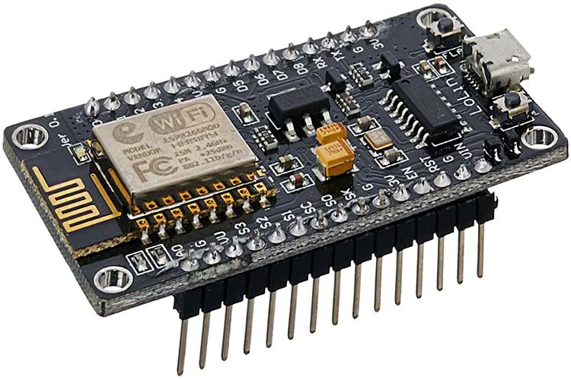
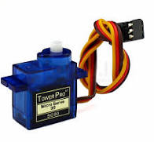
COMPONENTS REQUIRED:
ESP8266 based Board (NodeMCU)
Servo Motor
Jumper Wires
Laptop
NodeMCU
Servo motor

Slide 5
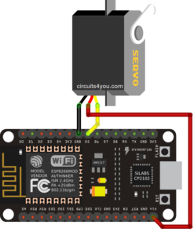
Circuit diagram:

Slide 6
CONNECTIONS:
Pin D5 of NodeMCU is connected to the orange wire of the servo motor and this pin provide the necessary PWM signal to the Servo motor depending on the pwm signal generated by NodeMCU the servo motor position is determined.
The red wire of servo is connected to the 5v (Vin pin).
And the brown wire is connected to ground.

Slide 7
WORKING:
The program is responsible for the operation. In this we are dumping the code into NodeMCU and connected it to a wifi network. The stepper motor is connected to the NodeMCU. Ensure that laptop also connected to the same wifi network. After the code is uploaded, if you open the serial monitor, you can see the status of the ESP8266 WiFi Module. After that you have to follow the below steps:
Set mode to station mode
Connect ESP8266 to WiFi and start web server.
Now we can proceed for web control.
Now Get IP address of ESP8266 from serial monitor and open it using any web browser. If everything is right, when you change the position of the slider, the position of the servo Motor will be changed.

Slide 8
ADVANTAGES:
Stepper motor gives accurate angle.
Circuit complexity is low.
We can control it through internet.
DISADVANTAGES:
The devices are connected to same WiFi network.
Limited range application.

Slide 9
APPLICATIONS:
To control the motor through internet.
We can operate servo motor present in remote location.
If it is extended, we can control the robot through internet.

Slide 10
THANK YOU

